Slide 1
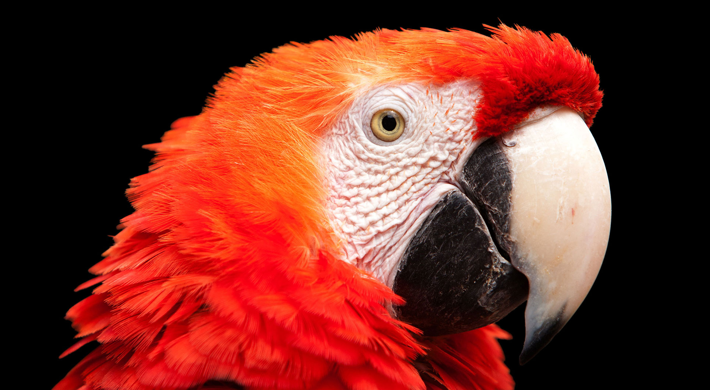
4.3 从小到大排好扑克牌
《Python青少年趣味编程》
小牛叔出品

Slide 2
1、 内容
Wenny继续教授如何玩转列表，现在他要求我们编写一个程序完成洗牌然后再排好序的功能。
poke = ["2","3","4","5","6","7","8","9","10", "J","Q","K","A","Joker-","Joker+"]

Slide 3
2、 洗牌
随机抽出一张牌pop()，然后再添加到牌末尾。如果这样循环持续完成26次，基本上每一张牌平均会被抽中2次。
import random
poke = [2,3,4,5,6,7,8,9,10,11,12,13,14]
for i in range(len(poke)*2):
poke.append(poke.pop(random.randint(0,len(poke)-1)))
print(poke)
poke.sort()
print('顺牌后:',poke)

